Slide 1
Lecture 5.
Binary Trees (2/2)
Instructor: 黄群
huangqun@pku.edu.cn
School of EECS
Peking University

Slide 2
Outline
Binary Heap
Special complete binary tree
Huffman Tree
Special full binary tree

Slide 3
Priority Queue: Motivation
Simple first-in first-out (FIFO) queues are not sufficient in practice
Are there any “smarter” structures?
Operations to support
Insertion
Delete (and access) minimum

Slide 4
Simple Implementations
There are multiple possibilities for the implementation.
Simple linked list (solution 1)
insert in front O(1)
delete minimum O(N)
Sorted linked list (solution 2)
insert O(N)
delete minimum O(1)

Slide 5
Simple Implementations
Binary search tree (solution 3)
O (log N) on average for insertion/deletion
Binary heap (solution in this lecture)
O (1) for finding the minimum
O (log N) for insert
O(N) worst-case to build a priority queue

Slide 6
Binary Heap (Heap): Logical Structure
Structure property
A heap is a special type of complete binary tree
that is completely filled, except at the bottom level, which is filled from left to right
A complete binary tree of depth d has 2^{d} ~2^{d+1}–1 nodes
The height of a complete binary tree = ⌊ log N ⌋

Slide 7
Required Property
Heap has additional property compared to complete binary tree
Heap Order Property
The value at any node should be smaller than all of its descendants (guarantee that the node with the minimum value is at the root)

Slide 8
Required Property
A Binary Search Tree
a heap
Note the difference in node ordering!!

Slide 9
Binary Heap: Logical Structure
A complete binary tree can be represented in an array without using pointers

Slide 10
A
B
C
D
E
F
G
H
I
J
0
1
2
3
4
5
6
7
8
9
10
11
12
13
14
The root is at position 0
For an element at position i,
its left child is at position 2i + 1;
its it right child at 2i +2;
its parent is at ⌊i/2⌋
0
1
2
3
4
5
6
7
8
9

Slide 11
Different Views of Heap
DeleteMin (H)
Priority Queue H
Insert (H, x)
Function level
Logical level
A
B
C
D
E
F
G
H
I
J
Implementation level
0
1
2
3
4
5
6
7
8
9
10
11
12
13
14

Slide 12
Heap Class
template <class T>
class MinHeap {
private:
T* heapArray; // Array of elements
int CurrentSize; // Current element number
int MaxSize; // Maximum number of element
int leftchild(int pos) const;
int rightchild(int pos) const;
int parent(int pos) const;
bool isLeaf(int pos) const;
void SiftUp(int position);
void SiftDown(int position)；
public:
MinHeap(const int n)； // n is the maximum number of element
virtual ~MinHeap(){delete []heapArray;};
bool Remove(int pos, T& node); // delete element at position
bool Insert(const T& newNode)；
void BuildHeap(); // Build Heap
T& RemoveMin()；
｝

Slide 13
Initialize
MinHeap (int MaxElements) {
// Allocate the array plus one extra for sentinel
heapArray = malloc ((MaxElements + 1) * sizeof (T));
if (heapArray == NULL)
FatalError ("Out of space!!!");
MaxSize = MaxElements;
CurrentSize = 0;
}

Slide 14
Two Operations to Maintain Heap Property
SiftUp
Move a small element up toward root
Stop when Heap Property holds
Used for insert operation
SiftDown
Move a large element down toward leaf
Stop when Heap Property holds
Used for delete operation

Slide 15
Sift Up Operation
Give an element X
If X can be placed in its hold without violating heap order, then complete
Otherwise: swap X with its parent
Continue this process until X can be placed in the position

Slide 16
Sift Up Operation
template<class T>
void MinHeap<T>::SiftUp(int position) {
int temppos=position;
T temp=heapArray[temppos];
while((temppos>0) && (heapArray[parent(temppos)] > temp)) {
// Fill parent’s element into current position
heapArray[temppos]=heapArray[parent(temppos)];
temppos=parent(temppos);
}
heapArray[temppos]=temp;// find out position
}

Slide 17
Insert with SiftUp: Example
We use an example to motivate the insert operation
Insert 14
13
13
21
16
21
16
24
31
19
68
24
19
68
65
26
32
65
26
32
31

Slide 18
Insert with SiftUp: Example
The remaining two steps to insert 14
13
13
16
14
16
24
21
19
68
24
21
19
68
65
26
32
31
65
26
32
31

Slide 19
Insert by SiftUp
To insert an element X,
Get the next available location in the array
Put X in the location
ShiftUp

Slide 20
Binary Heap: Insert
template <class T>
bool MinHeap<T>::Insert(const T& newNode)
{
if(CurrentSize==MaxSize) // full already
return false;
heapArray[CurrentSize]=newNode;
SiftUp(CurrentSize);
CurrentSize++;
}

Slide 21
Sift Down Operation
Given an element X
If X is smaller than the child(ren), job is done
Some node may have only one child (be careful when coding!)
Otherwise slide the smaller of X’s children into X’s hold, thus pushing the hole down one level
Repeat the previous step until X can be placed in the hole

Slide 22
SiftDown Operation
template <class T>
void MinHeap<T>::SiftDown(int position) {
T temp = heapArray[i]; // Save root node
int i = position; // parent node
int j = 2*i+1; // child node
while (j < CurrentSize) {
if ((j < CurrentSize-1) && (heapArray[j] > heapArray[j+1]))
j++; // find smaller child
if (temp > heapArray[j]) { // compare with smaller child
heapArray[i] = heapArray[j];
i = j;
j = 2*j + 1;
}
else break;
}
heapArray[i]=temp; // Put root node in right position
}

Slide 23
DeleteMin: Procedure
The element at the root is to be removed, and a hole is created
Move the last element in the array to the root
SiftDown

Slide 24
DeleteMin (Observation)
Creation of the hole at the root
Leave the last element in the array
13
14
16
14
16
24
21
19
68
24
21
19
68
65
26
32
31
65
26
32
31

Slide 25
DeleteMin (Observation)
Next two steps in DeleteMin
14
14
16
21
16
24
21
19
68
24
19
68
65
26
32
31
65
26
32
31

Slide 26
DeleteMin (Observation)
Last step in DeleteMin
14
21
16
24
31
19
68
65
26
32

Slide 27
Complexity of Insert and DeleteMin
Insert
Worst case running time is O (log N)
the new element is percolating up all the way to the root.
DeleteMin
Worst case running time is O(log N)
On average, the hole is percolated almost to the bottom of the heap, so the average running time is O(log N) again

Slide 28
Binary Heap: Other Operations
There is no way to find any particular key without a linear scan through the entire heap.
However, if we know the position, we can access the key immediately.

Slide 29
General Delete Operation
The element at the given position is removed, and a hole is created
Move the last element in the array to the hole
SiftUp or SiftDown
Only need either direction
SiftUp for small element
SiftDown for large element

Slide 30
General Delete Operation
template<class T>
bool MinHeap<T>::Remove(int pos, T& node) {
if((pos<0)||(pos>=CurrentSize))
return false;
T temp=heapArray[pos];
heapArray[pos]=heapArray[--CurrentSize];
if (heapArray[parent(pos)]> heapArray[pos])
SiftUp(pos);
else
SiftDown(pos);
node=temp;
return true;
}·

Slide 31
Example
Delete 68
05
63
16
68
94
36
40
73
120
130
150
45

Slide 32
Example
Delete 16
05
63
16
68
94
36
40
73
120
130
150
45

Slide 33
Binary Heap: Other Operations
DecreaseKey (int pos, T ∆)
Goal: Lower the key value at position P by a positive value ∆
Key idea: Fix the heap order by sifting up
// We may have IncreaseKey(int pos, T ∆) similarly
Delete (int pos, T node): Remove the node at position P
// Another implementation of deleting element at position pos
DecreaseKey (P, ∞, H) and DeleteMin (H)

Slide 34
BuildHeap
BuildHeap()
Given n unordered keys, how to build a heap?
Solution 1: Insert each element one by one
Time complexity: O(N log N) worst-case
Solution 2:
Put all elements into the array first
Then SiftDown()
All leaves are already heaps
Call SiftDown() from node ⎣n/2⎦ - 1 to 0

Slide 35
BuildHeap: Example
n=8
72
?23 < 05
?72 < 05
73
71
i=0
?16 < 05
?71 < 05
?23 < 94
?73 < 23
? 72 < 16
23
94
16
05
i=1
i=2
i=3
? 23 < 68
? 73 < 68
68

Slide 36
BuildHeap: Complexity Analysis
For a heap with n nodes
the depth d = ⌊log₂n ⌋
there are 2^{i} nodes with depth i
Consider the number of SiftDown operations…
About a half nodes at depth d-1 (leaves)
About a quarter nodes at depth d-2, which move down at most one level
At every upper level, the max distance to move is increased by 1, but the number of nodes to move halves
Time complexity

Slide 37
Applications of Priority Queues
Find the k-th smallest elements
It requires k DeleteMin operations.
O(N) to create the heap.
O(log N) for each DeleteMin.
Total running time is O(N + k log N).
If k = O(N / log N), running time is O(N).
For large value of k, running time is O(k log N).

Slide 38
Outline
Binary Heap
Special complete binary tree
Huffman Tree
Special full binary tree

Slide 39
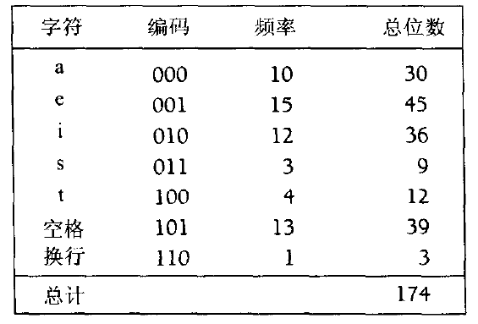
Motivation
Consider a file composed using 7 characters
A naïve encoder would encode each character using the same number of bits
ceil(log(7)) = 3 bits in this example

Slide 40
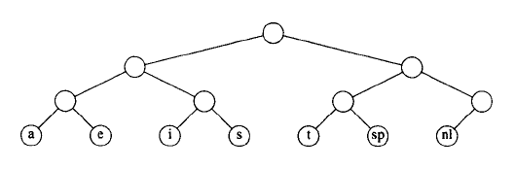
A Tree Representation of Encoding
000 001 010 011 100 101 110

Slide 41
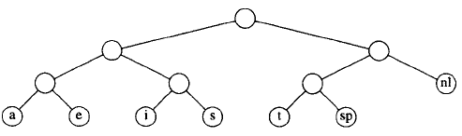
A Tree Representation of Encoding
Optimization
000 001 010 011 100 101 110
Will not cause ambiguity because ‘11’ is not a prefix of other codes
11
000 001 010 011 100 101

Slide 42
Prefix Code
Prefix property
no code word in the system that is a prefix of any other code word in the system
a.k.a, comma-free code
Examples
County calling codes: +86
Is there a country code +861?
UTF-8
Universal Coded Character Set
UTF-8 (Unicode Transformation Format): 1-4 bytes for each character

Slide 43
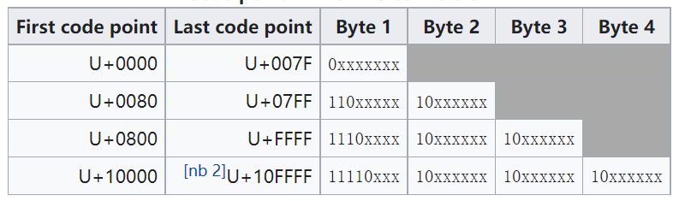
Prefix Code: Example
UTF-8

Slide 44
Huffman Coding
A prefix coding
Leverage frequency of characters
High frequent characters
Less bits
Low frequent characters
More bits

Slide 45
Huffman Coding
Optimal prefix code in data communication
Assume C = { c₀, …, c_{n-1} }, W = { w₀, …, w_{n-1} }
where C is the characters to be encoded
W is the frequency of occurrences in D
Optimality
Σ_{i=0}^{n-1} w_{i} l_{i} is minimized, where l_{i} is the code length of c_{i}
The solution can be found via a Huffman Tree
Notes:
In 1951, David A. Huffman and his MIT information theory classmates were given the choice of a term paper or a final exam. The professor, Robert M. Fano, assigned a term paper on the problem of finding the most efficient binary code. Huffman, unable to prove any codes were the most efficient, was about to give up and start studying for the final when he hit upon the idea of using a frequency-sorted binary tree and quickly proved this method the most efficient. [Ken Huffman 1991]

Slide 46
Huffman Tree
Weighted external path length
Given n nodes with weights w₀, w₁, …, w_{n-1} (n ≥ 2)
Construct an binary tree with exactly n leaves
Weighted external path length = Σ_{i=0}^{n-1} w_{i} l_{i}
where l_{i} is the depth of the node with weight w_{i}
Huffman tree
A binary tree with the minimum weighted external path length given a set of weights

Slide 47
Huffman Tree: Examples
The following trees have 4 external nodes with weights 6, 2, 3, 4, respectively
Example 1: 6x2 + 2x2 + 3x2 + 4x2 = 30
Example 2: 6x2 + 2x3 + 3x3 + 4x1 = 31
Example 3: 6x1 + 2x3 + 3x3 + 4x2 = 29
4
6
6
4
6
2
3
4
2
3
2
3

Slide 48
Huffman Coding and Huffman Tree
For example, the frequencies of characters a, b, c, d, e, f, g, in a communication system are 15%, 2%, 6%, 5%, 20%, 10%, 18%, respectively
The binary code is
a: 00; b: 11110; c: 1110
d: 11111; e: 10; f: 110; g: 01

Slide 49
Key Problems
Building a Huffman Tree
Encode based on the Huffman Tree
Decode based on the Huffman Tree

Slide 50
Building a Huffman Tree
Input: weights w₀, w₁, …, w_{n-1} (n ≥ 2)
Output: a Huffman tree with weights at the leaves
Algorithm
Build a set of trees T = { T₀, T₁, …, T_{n-1} }, such that T_{i} has a single node with weight w_{i}
Find two trees from T with the smallest weights, and replace them by a new tree (using a heap)
The two trees are the left and right subtrees, respectively
Weight of new tree is sum of its left and right subtrees
Repeat the previous step until T has only one tree remaining

Slide 51
Example
238
95
143
42
53
65
78
24
34
17
10
5
2
3
5
7
11
13
17
19
23
29
31
37
41

Slide 52
Correctness Analysis
Theorem: the constructed tree has minimum weighted external path length (WEPL)
Sketch of Proof (By induction)
It is easy for n=2 leaves
Assume Huffman Trees with n-1 leaves have minimum WEPL
For a Huffman Tree T_{n} with n leaves
Its leaves have weights w₁ < w₂ … < w_{n}
We must have: w₁ and w₂ are siblings and are the deepest leaves in T_{n}
Proved as a Lemma in some textbooks
Reduce T_{n} to (n-1)-leaves Huffman Tree T_{n-1} : replace w₁ and w₂ by a node with weight w₁ + w₂
T_{n} has minimum WEPL for n given that T_{n-1} has minimum WEPL for n-1

Slide 53
Encode based on Huffman Tree
Input: a Huffman tree and a character set
Algorithm
Travel the tree:
Edge to left subtree marked as “0”
Edge to right subtree marked as “1”
When reaching a leave: coding for a character
A character is a leave in Huffman Tree
Coded as binary string from root to the leave

Slide 54
Example
0
238
1
95
143
0
1
0
1
42
53
65
78
0
1
0
1
0
1
0
1
19
23
24
29
31
34
31
47
d
10
0
1
d
11
d
12
d
d
8
0
1
d
9
17
17
7
11
13
0
1
d₀ ： 1011110 d₁ ： 1011111
d₂ ： 101110 d₃ ： 10110
d₄ ： 0100 d₅ ： 0101
d₆ ： 1010 d₇ ： 000
d₈ ： 001 d₉ ： 011
d₁₀： 100 d₁₁ ： 110
d₁₂： 111
d
4
d
5
d
6
7
0
10
1
d
3
5
5
d
2
0
1
d
0
2
3
d
1

Slide 55
Decode based on Huffman Tree
Input: a binary string and a Huffman Tree
Key idea: scan the binary string, until a character is determined
Algorithm
Start from the root
Access left subtree for bit 0, or
Access right subtree for bit 1
When reaching a leave, obtain a character
Repeat from the root

Slide 56















238
0
1
95
143
0
0
1
1
42
53
65
78
0
0
1
0
1
0
1
1
31
34
31
47
19
23
24
29
1
$$d_{10}$$
0
$$d_{12}$$
$$d_{7}$$
0
1
$$d_{9}$$
$$d_{11}$$
$$d_{12}$$
$$d_{8}$$
17
17
11
13
0
1
$$d_{6}$$
$$d_{4}$$
$$d_{5}$$
7
10
0
1
String：111 101110
$$d_{3}$$
5
5
$$d_{2}$$
0
1
$$d_{2}$$
2
$$d_{0}$$
3
$$d_{1}$$

Slide 57
Summary
Binary Heap
Structure
Sift Up & Sift Down
Insert & DeleteMin
Other operations
Huffman Tree
Build tree
Encode & Decode

Slide 58
Recommended Readings
Weiss, “DS & Algo. Analysis in C++” (3rd ed.)
Section 4.8 Sets and Maps in the STL
Section 6.1-6.4 Priority Queues (Heaps)

